Slide 1

Billing & Support Services

Slide 2
Simple Monthly Calculator

Slide 3
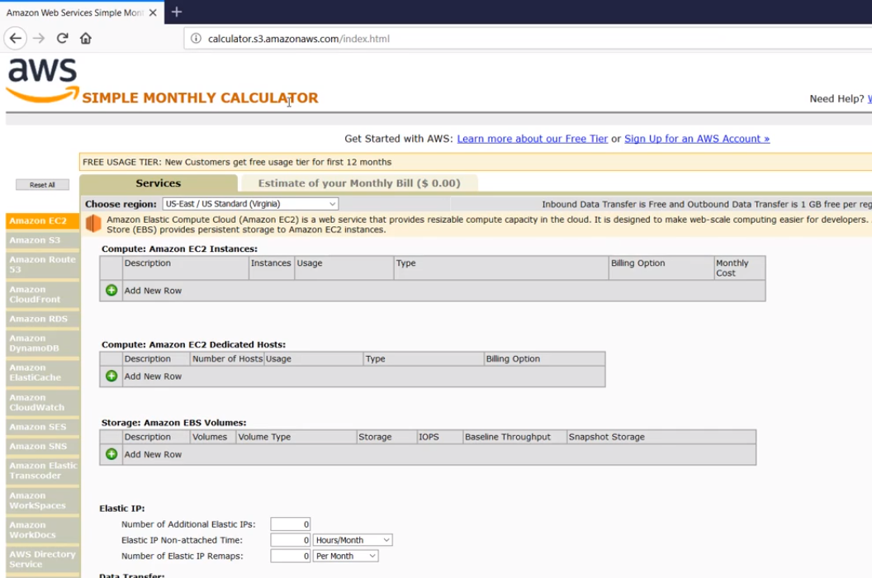

Slide 4
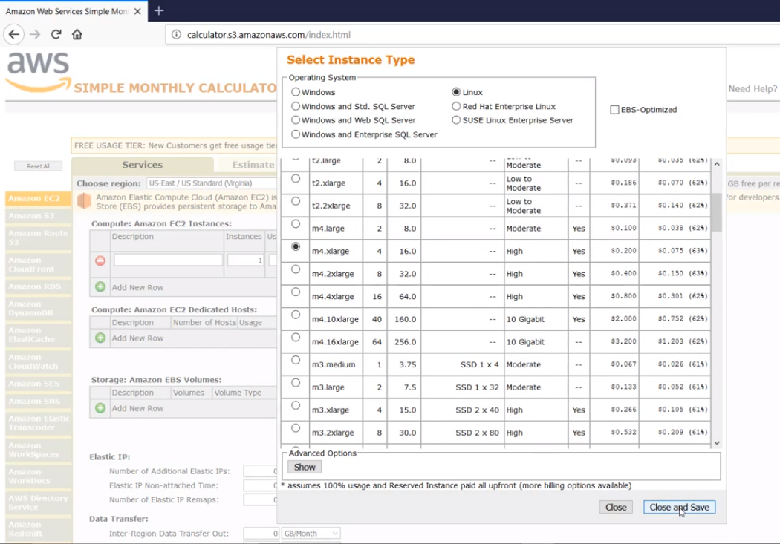

Slide 5
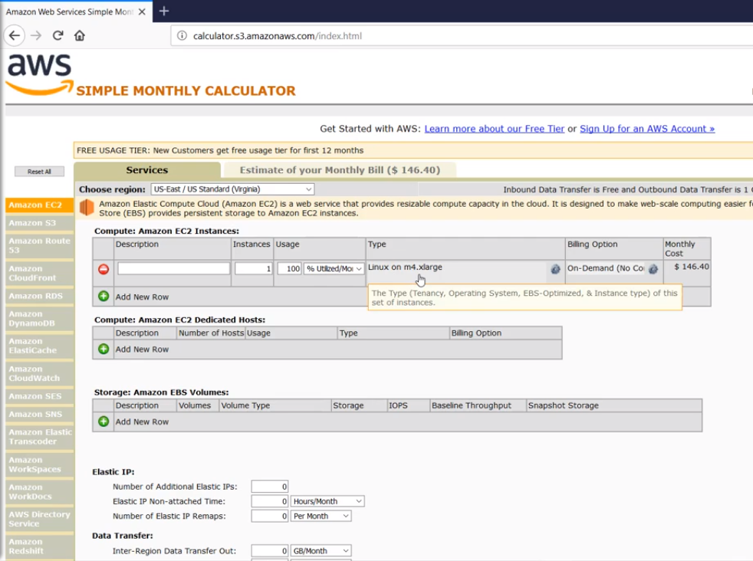
Click Here

Slide 6
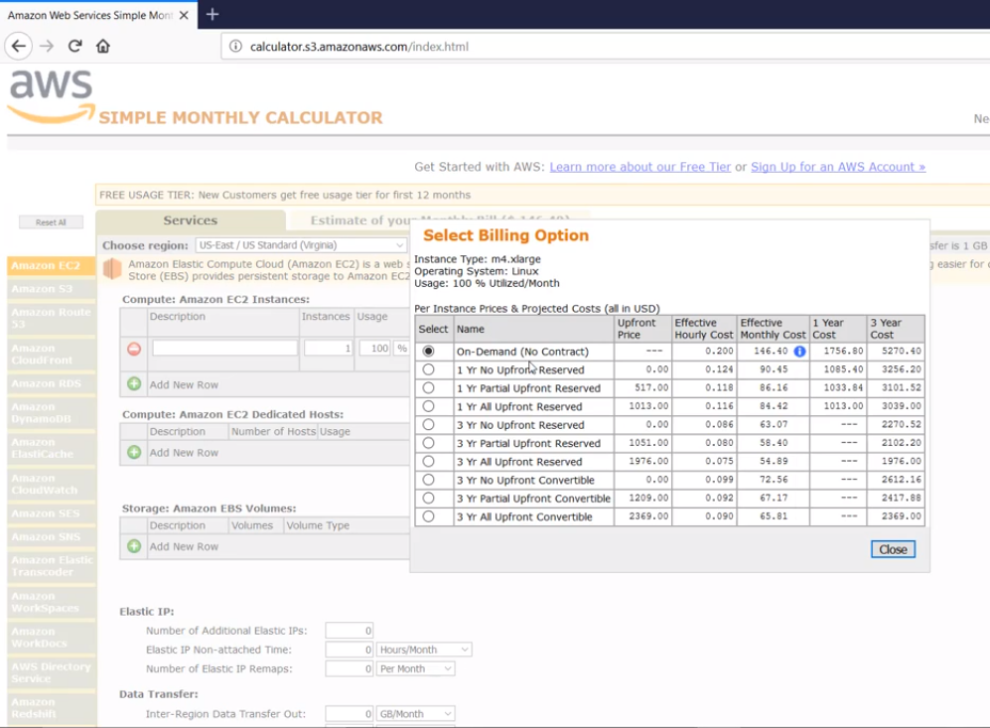
Click Here

Slide 7
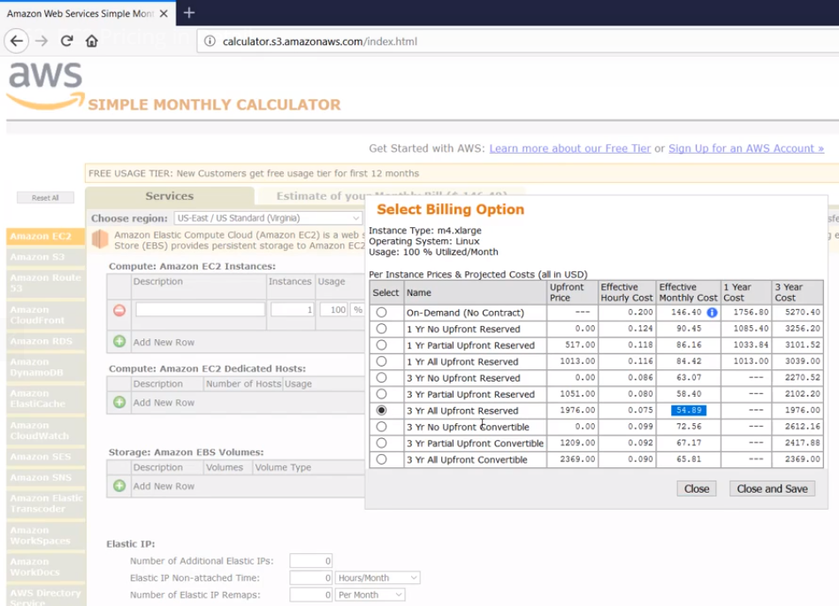

Slide 9
AWS Support Plan

Slide 10

Understanding AWS Support
AWS Support is one of the most direct ways in which customers can interact with the AWS cloud support engineers to understand, troubleshoot their problems.
It is for those who are:
Experimenting with AWS
Production use of AWS
Business Critical use of AWS

Slide 11
Support Plans
There are four major type of AWS support Plans:
Basic
Developer
Business
Enterprise
Depending on the type of use-case, workloads and criticality of application you are running, an organization can choose to go with any of the above plans.

Slide 12
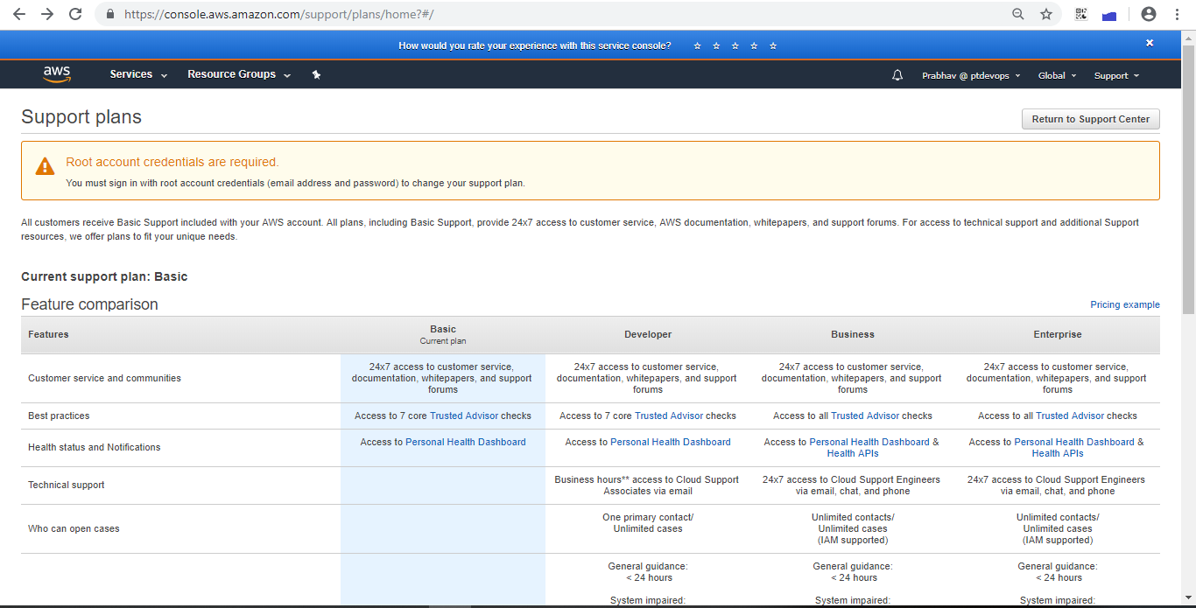
https://aws.amazon.com/premiumsupport/plans/

Slide 13
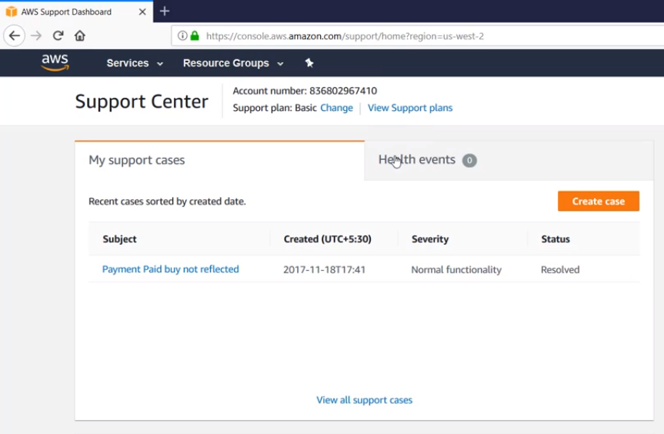

Slide 14
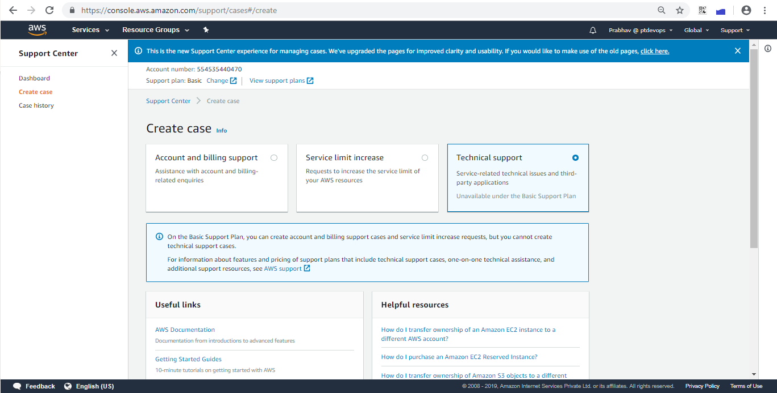
Click Here

Slide 15
Business Support Plan

Slide 16
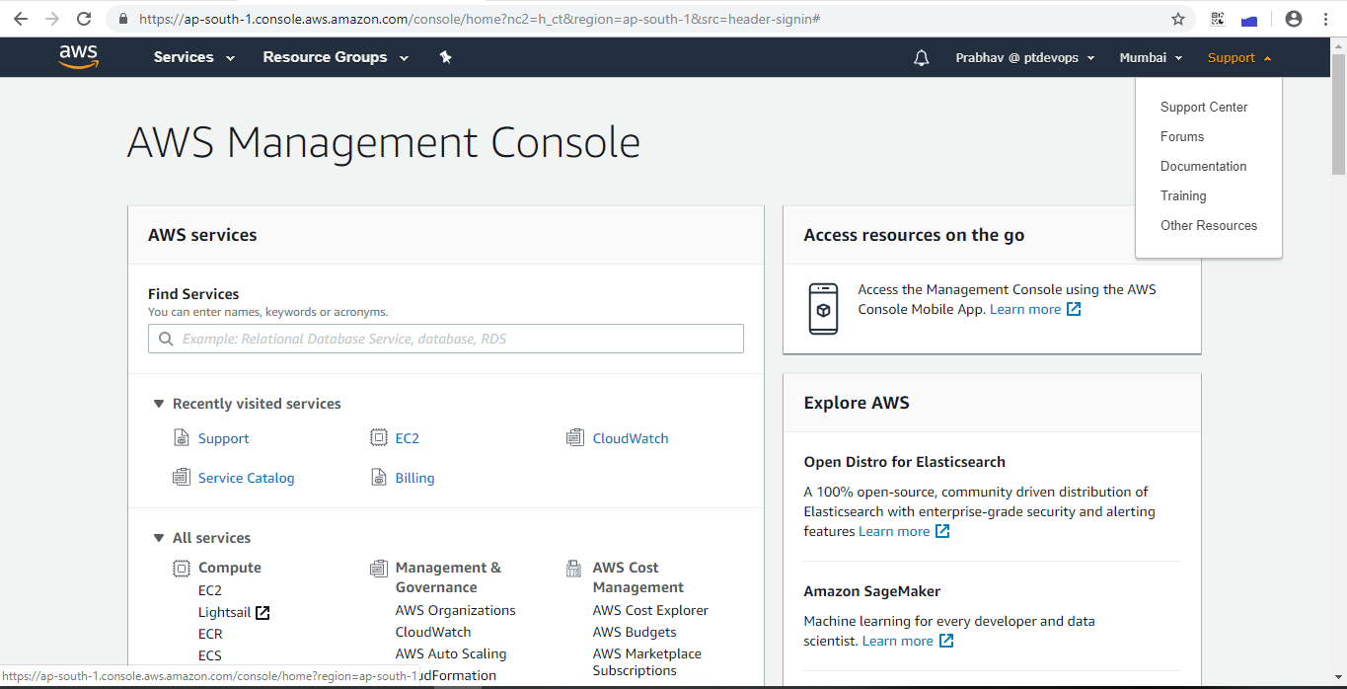

Slide 17
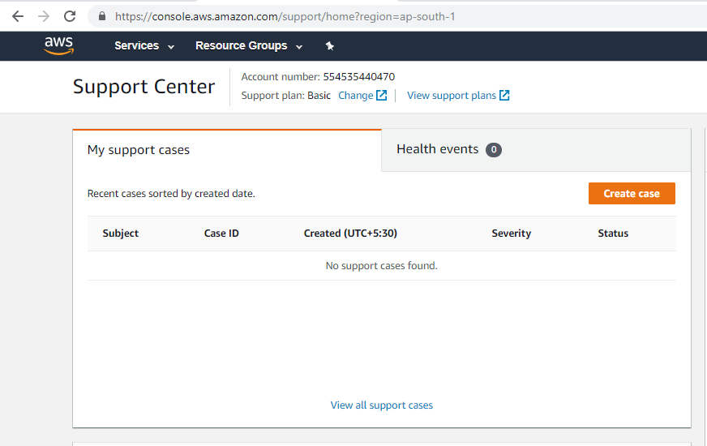
Click Here

Slide 18
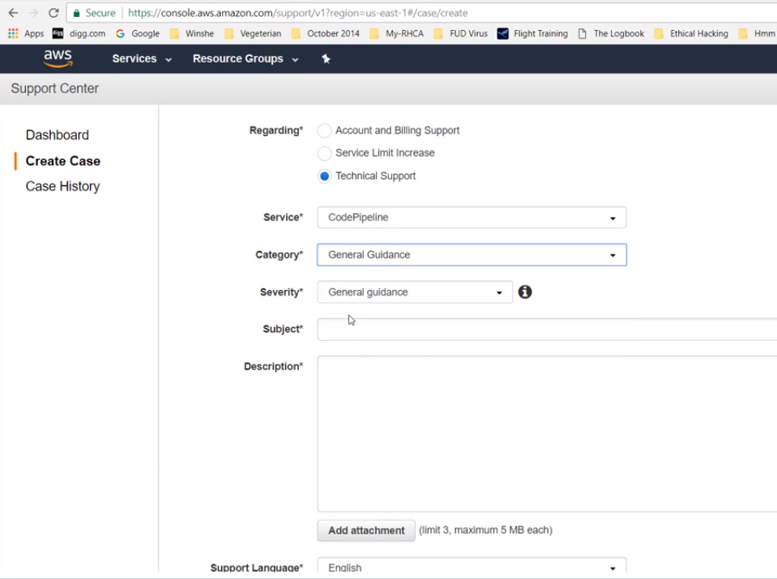

Slide 19
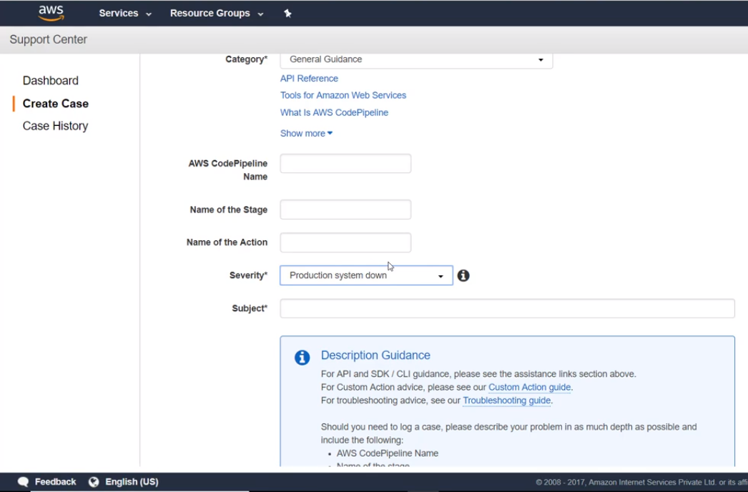

Slide 20
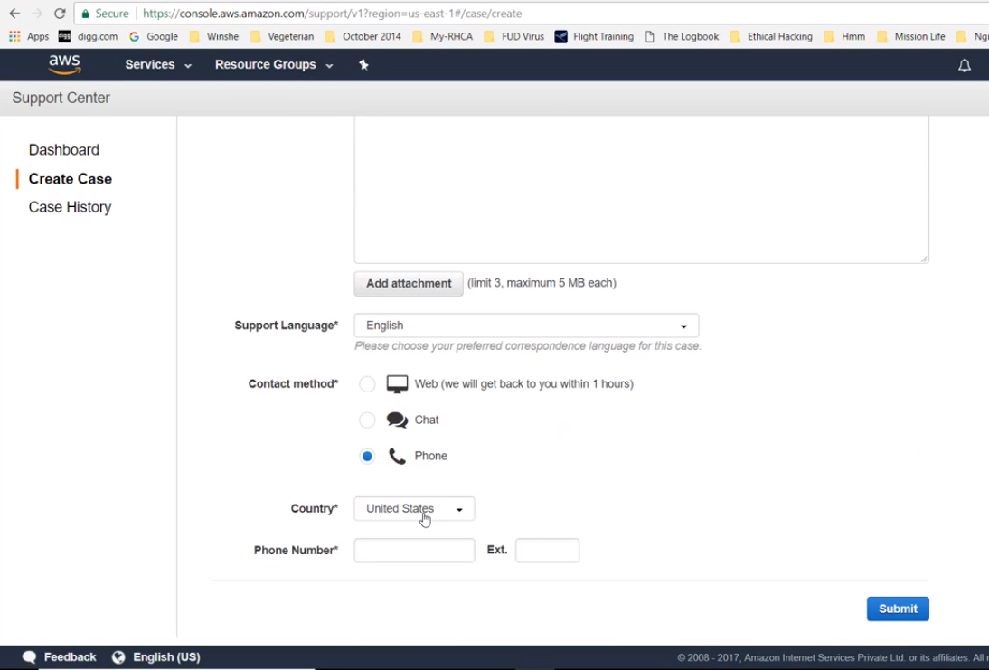

Slide 21
The TCO Calculator

Slide 22
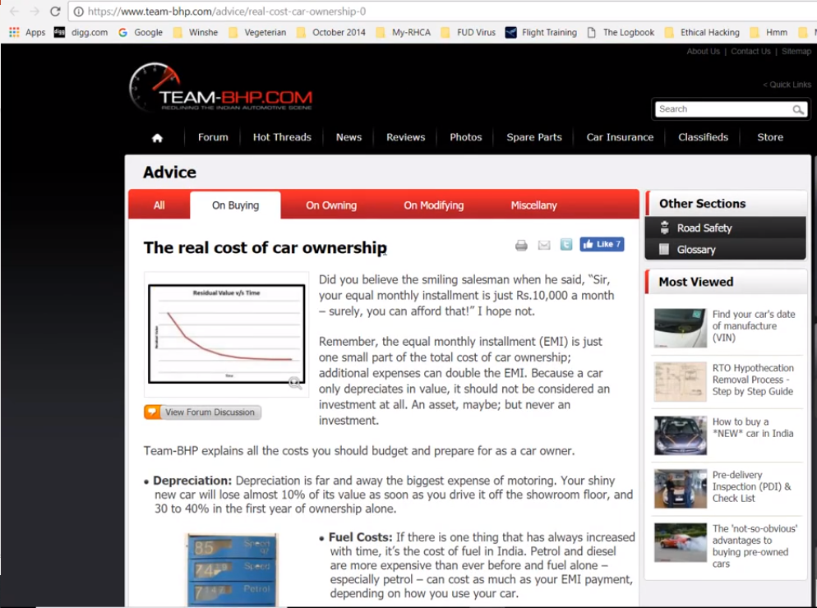

Slide 23
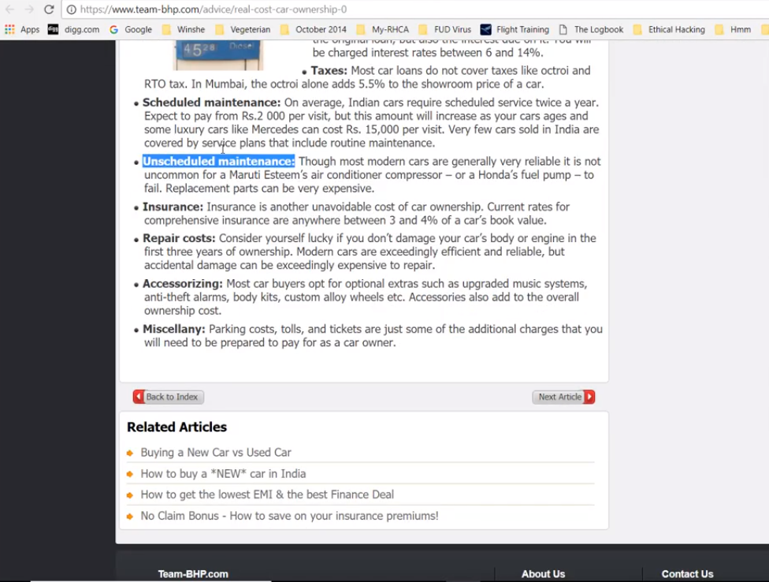

Slide 24
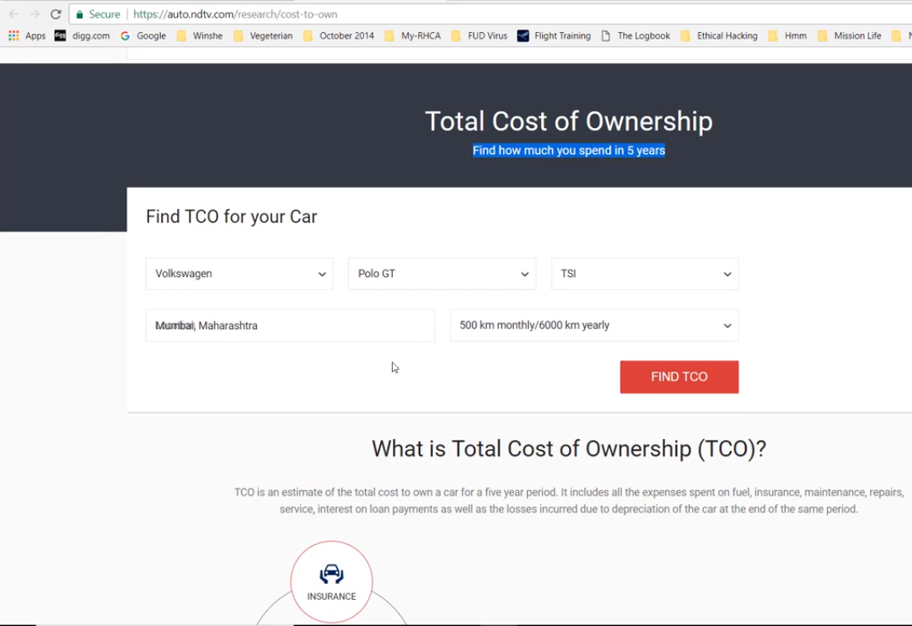
Click Here

Slide 25
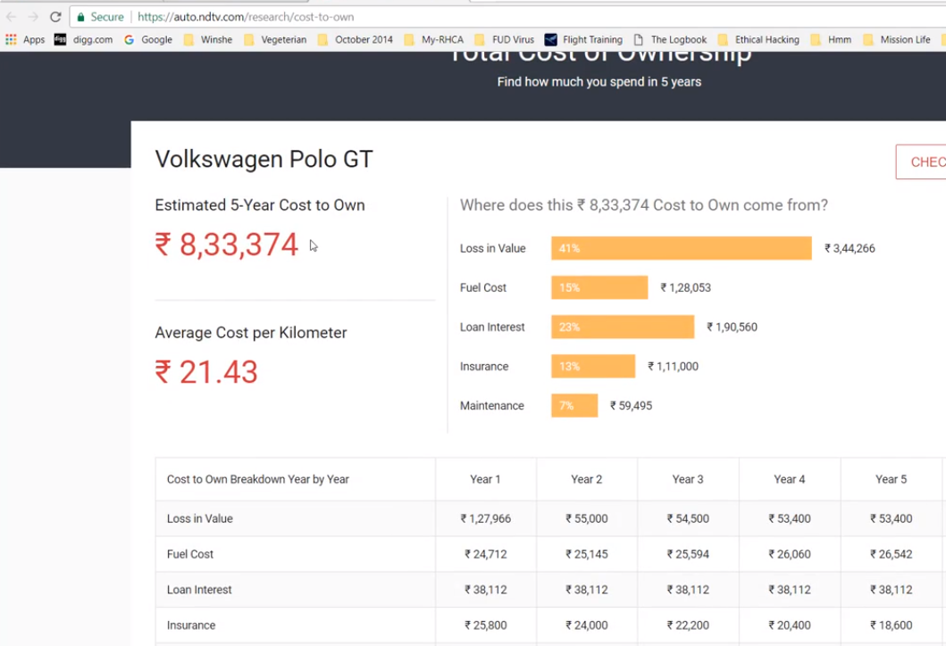

Slide 26

It all starts with your goal
Business always needs to thrive upon the definitive goals that have been set.

Slide 27

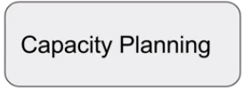

Developing Business Case to Move
Whenever we speak about our “business Case” , we need to understand the
Business demand.
Know your business demand.
How do you expect to grow
in the longer term ?
Is existing infra flexible to
meet those demand in cost
effective way ?
What is average server utilization
How much is over provisioned for
peak load ?
Storage capacity is good ?
Are you highly available ?

Slide 28
Datacenter vs AWS
Pointers | Data Center | AWS
Pay as you go model | X | Available
Stop guessing capacity | X | No need to worry
Lower overall cost | X | No need to worry
Agility to scale | X | Yes
Go global in minutes | X | Yes

Slide 29
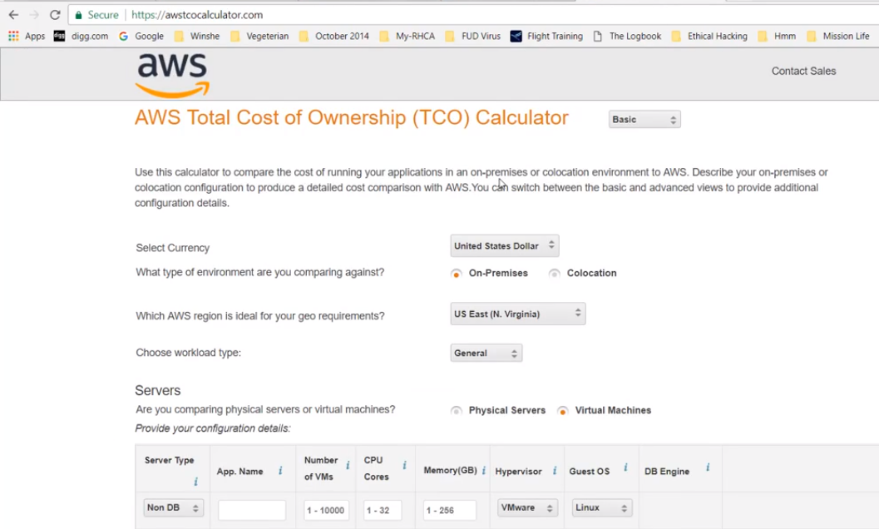

Slide 30
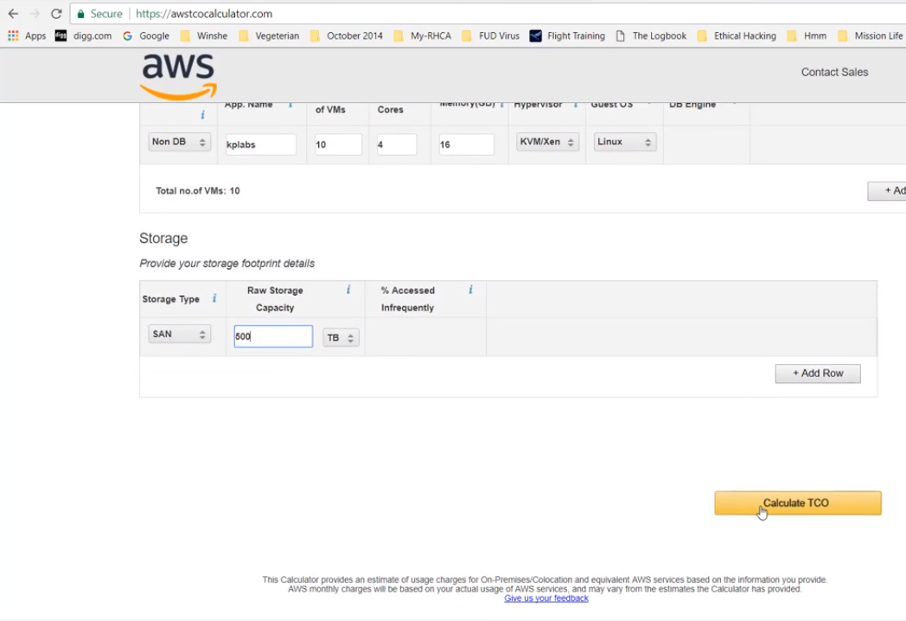

Slide 31
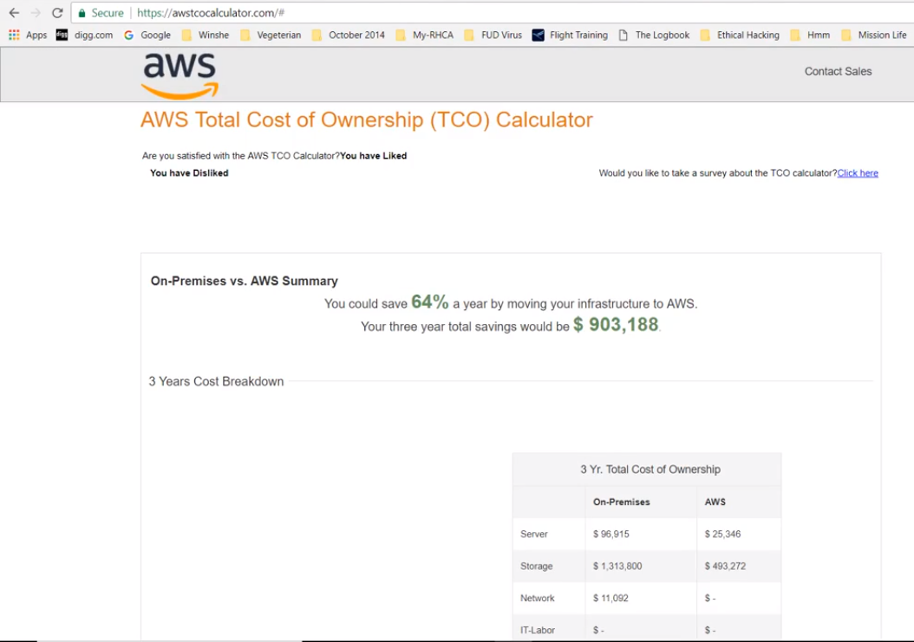

Slide 32
Consolidated Billing

Slide 33

Many AWS Accounts
Lots of organization are following approach of having multiple AWS accounts.
For example, separate AWS account for DEV , Staging, Production
It brings quiet a lot of benefits which includes security as well as costing.

Slide 34
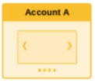
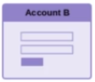
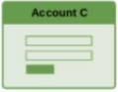
What many startups do ?
A startup has 3 AWS accounts which they use to separate their environments as part of good security best practice. At end of the month, they get 3 separate bills and they pay for each account individually.

Slide 35
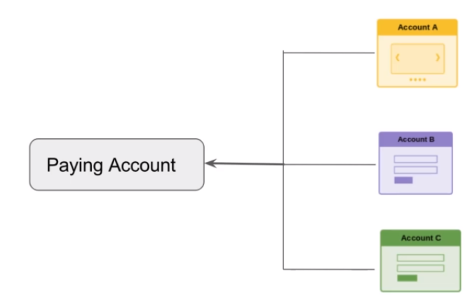
Consolidated Billing
We need to link our AWS account with the central paying account through
AWS Organizations.

Slide 36
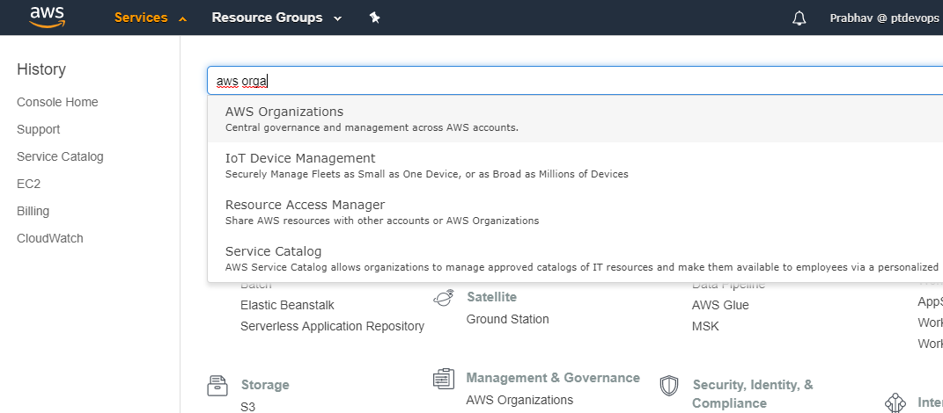

Slide 37
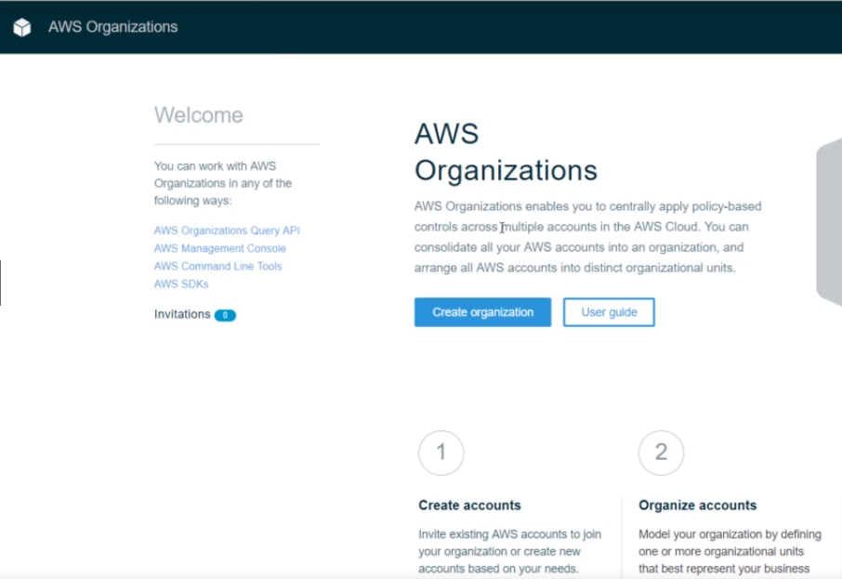
Click Here

Slide 38
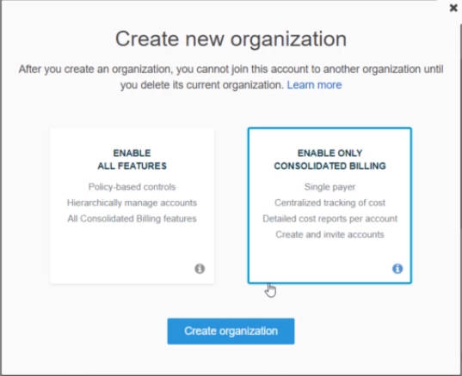
Click Here
Click Here

Slide 39
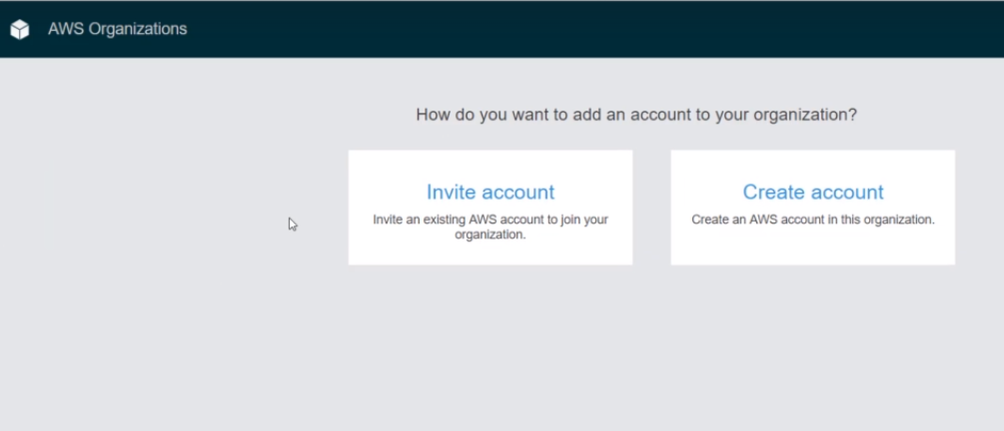

Slide 40
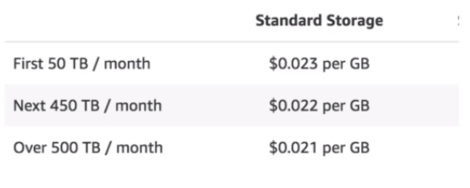
Benefits
There are a lot of benefits of consolidated billing:
One bill per linked AWS account.
It becomes quite easy to allocated costing and budgets.
Benefits of volume pricing discounts.
Benefits when using reserved instances as well.

Slide 41
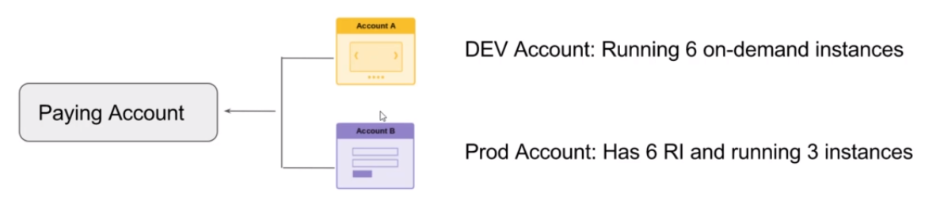
Reserved Instance Benefits
Total Bill : We will be billed for 6 RI and only 3 on-demand instances.

Slide 42

Important Pointers & Best Practices
Paying account should be used for billing purpose only. Do not deploy resource there.
By Default, we can have maximum of 20 linked accounts.
Paying account is an individual account and does not have access to resources of the other accounts.

Slide 43
Thank You

